Slide 1
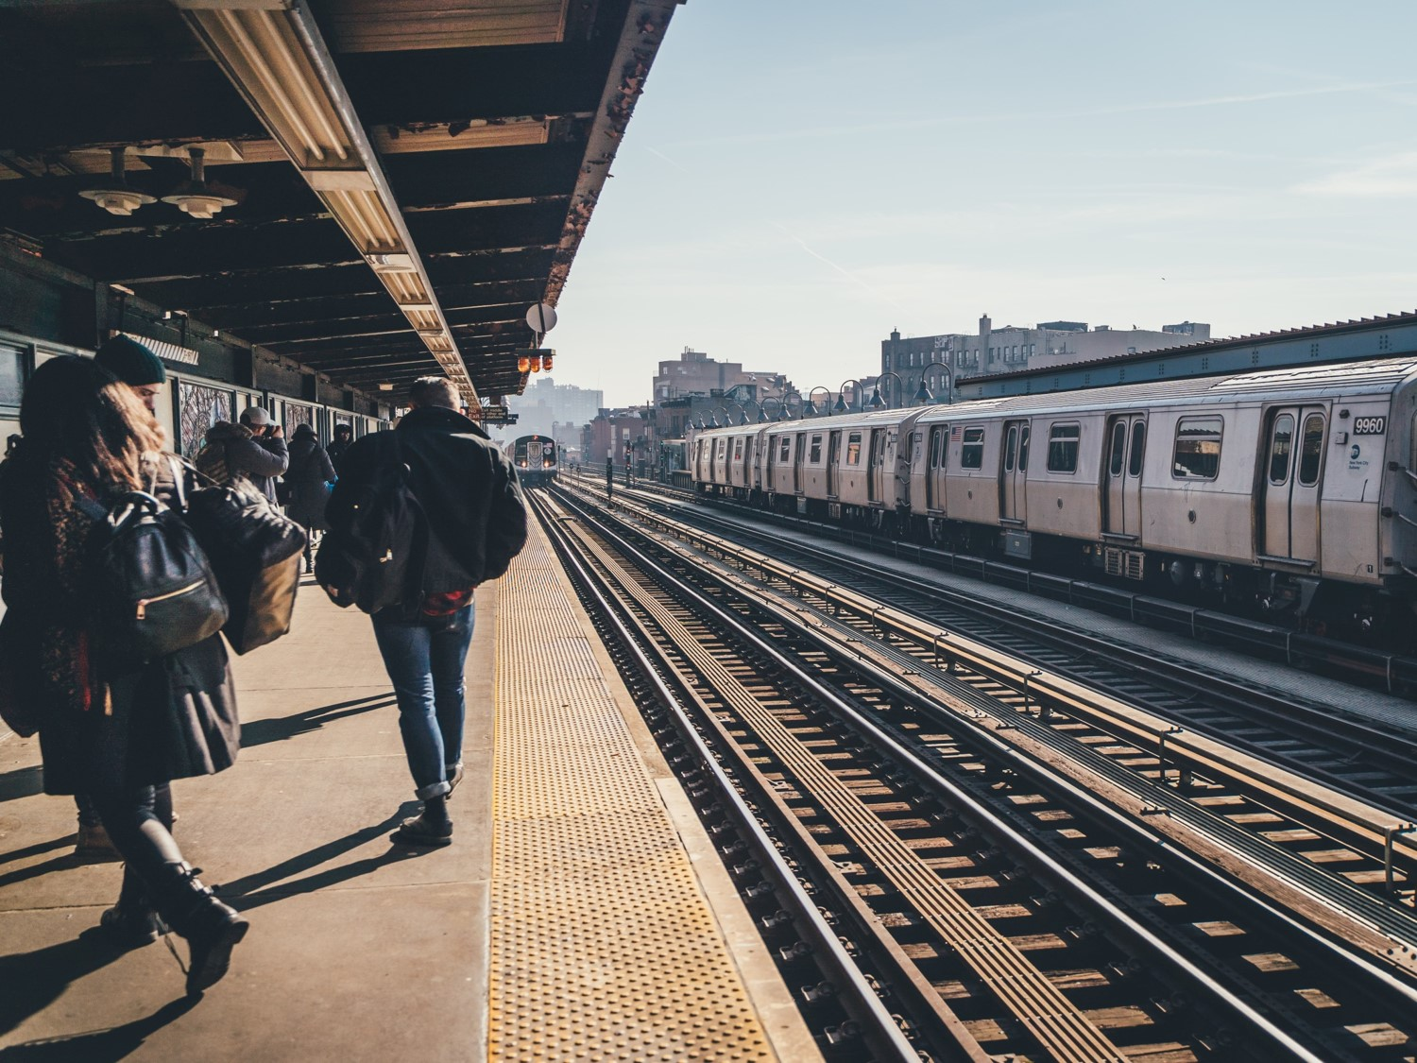


PROJECT 1:
WTWY STREET TEAMS
DEPLOYMENT PROPOSAL
ANDREW TAN
KELVIN CHOW
SI TING
SIU-YIN

Slide 2


GOAL
WTWY street teams wants obtain the most email signups for their annual OMGYN Gala in NYDC
TARGET: Adult Commuters

Slide 3
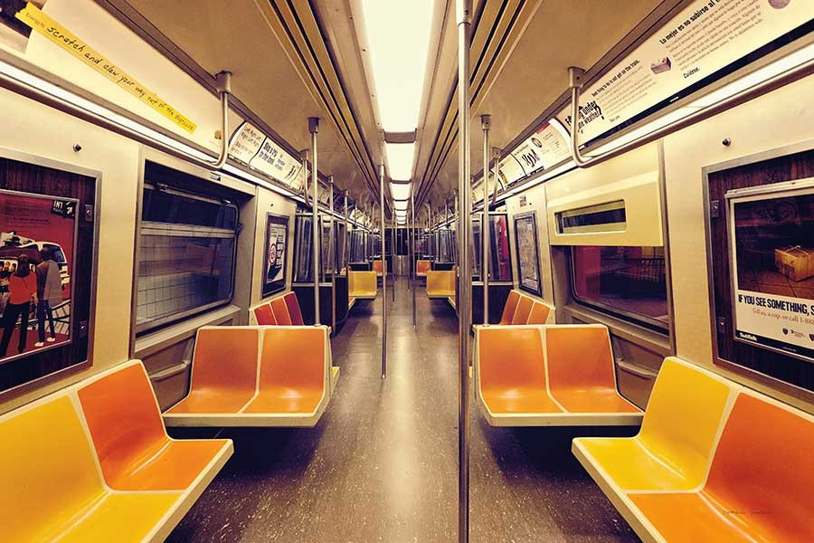
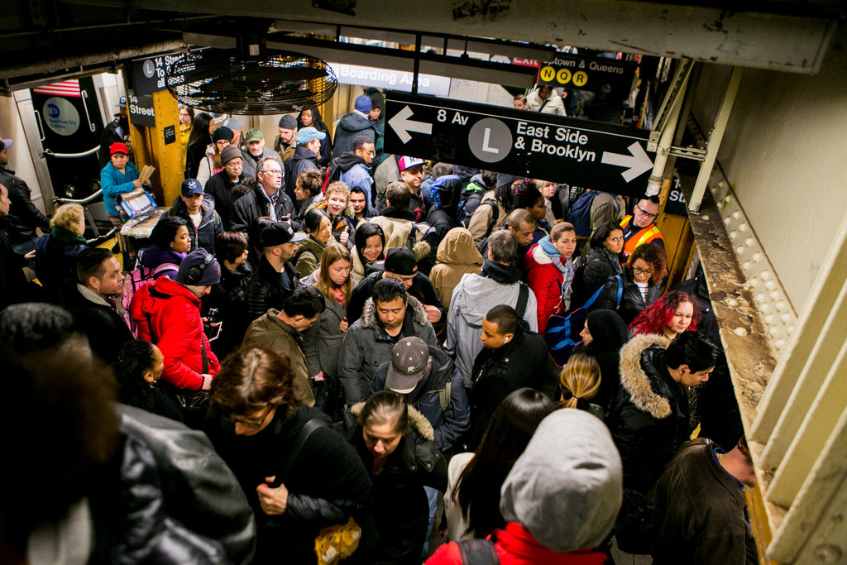

OUR APPROACH
Find out the which Stations and Days in a week to deploy WTWY’s resources

Slide 4

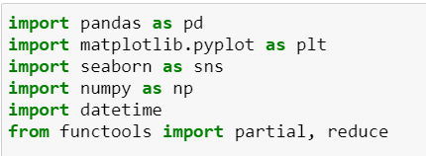


PYTHON TOOLS

Slide 5


DATA INFORMATION
Retrieved from MTA web online
Period: 4 Weeks
WE OBSERVE THAT …
Turnstile count is recorded in a cumulative manner, indicating that data recorded increases constantly over time -> difference between each row data for entries/exits is the actual human traffic
Dataset does not include day of the week
No fixed time is recorded
… SO LET’S CREATE THEM!

Slide 6


LET’S FILTER…
Drop unnecessary columns
Remove any duplicate/null/outliers (based on threshold of total seconds/day on the assumption that each sec cannot have more than 1 person doing turnstile)
LIMITATIONS
Lack of Data on the Demographics of commuters (Age, Sex) to determine the match for our target group

Slide 7

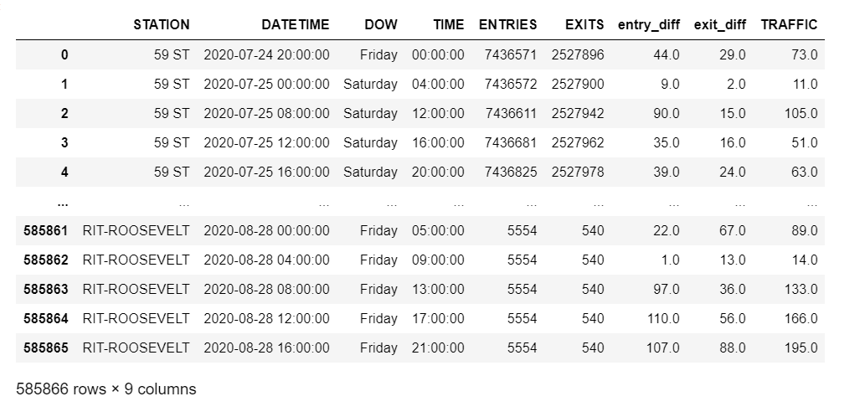
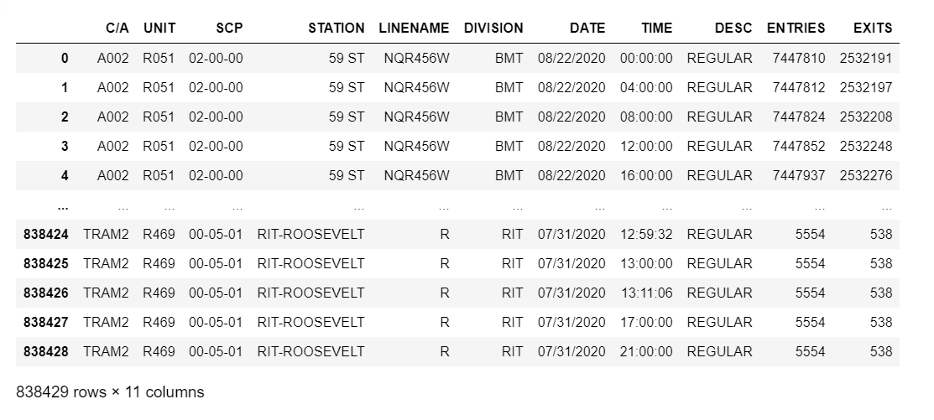


Slide 8
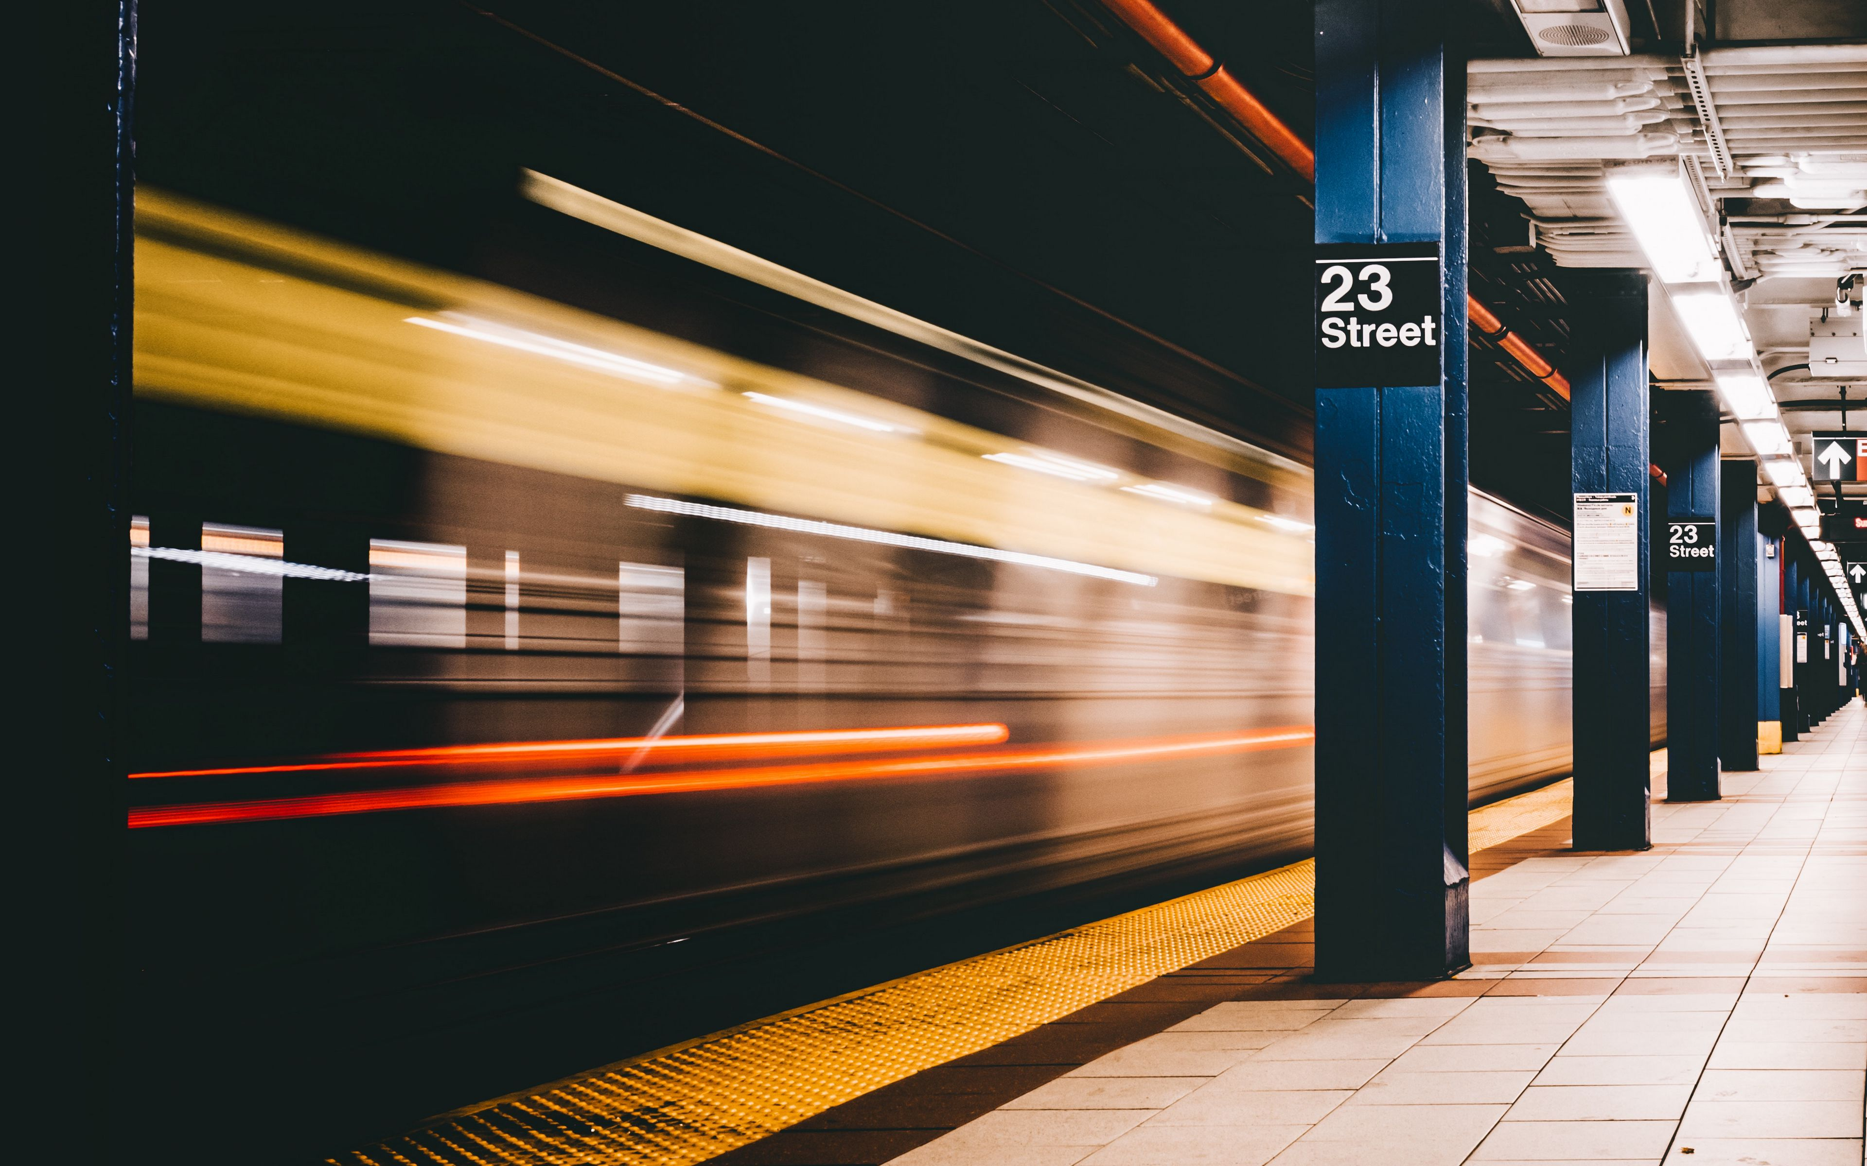
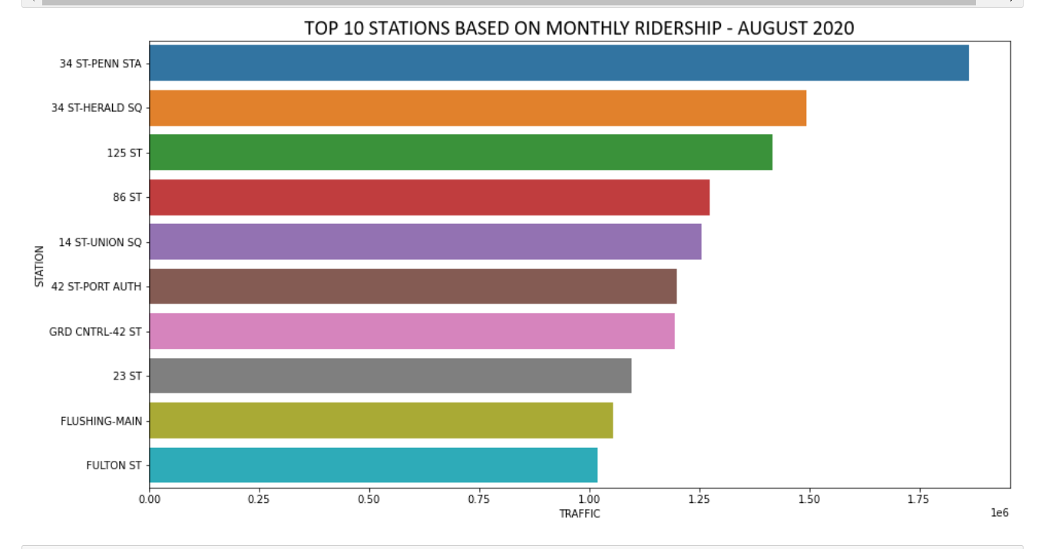
FINDINGS – TOP STATIONS

Slide 9
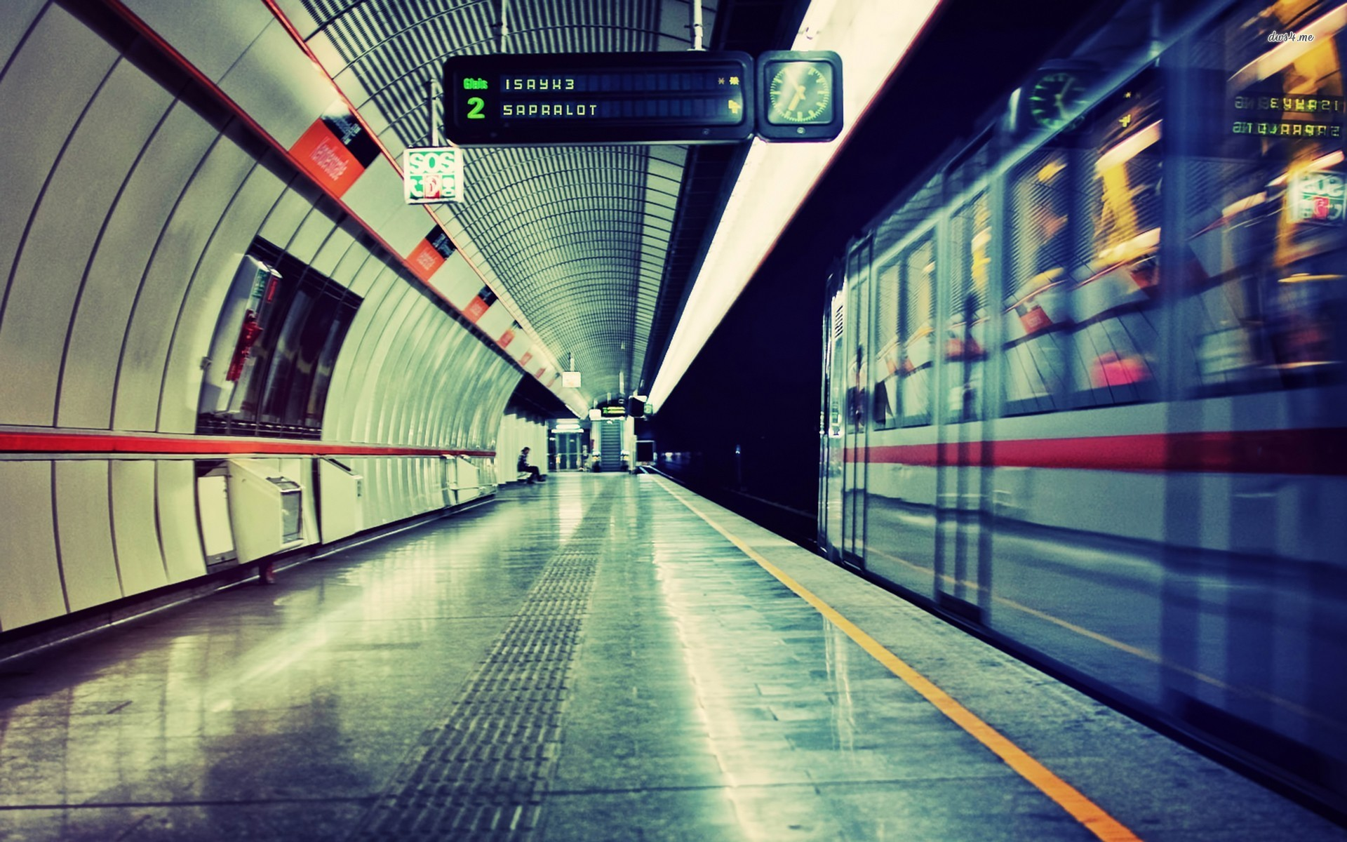
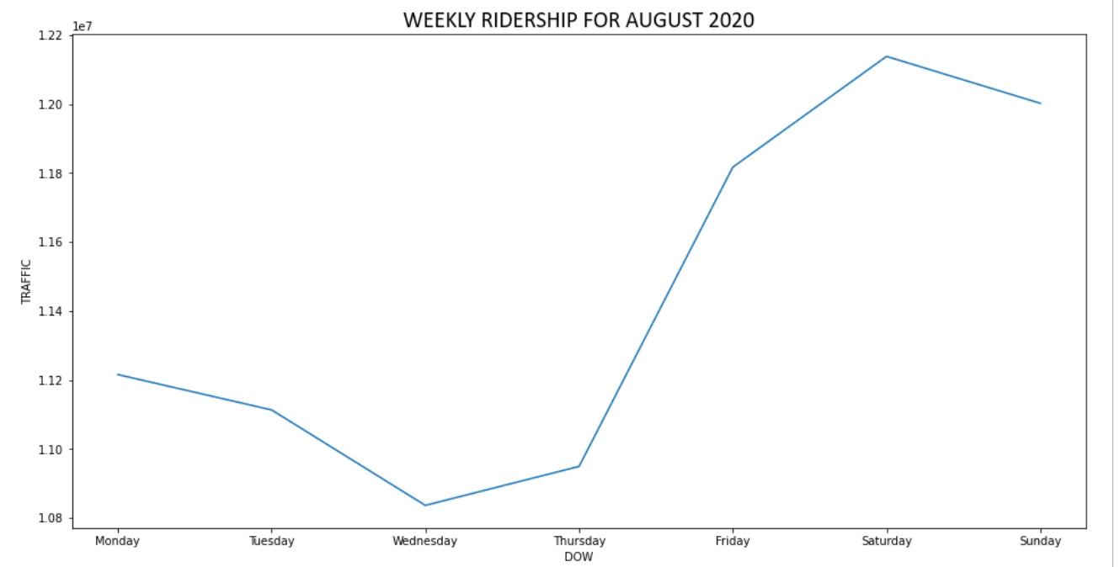
FINDINGS – WEEKLY TRAFFIC

Slide 10
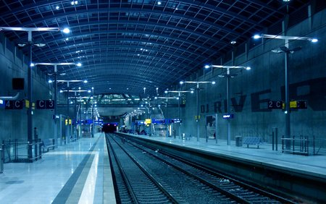
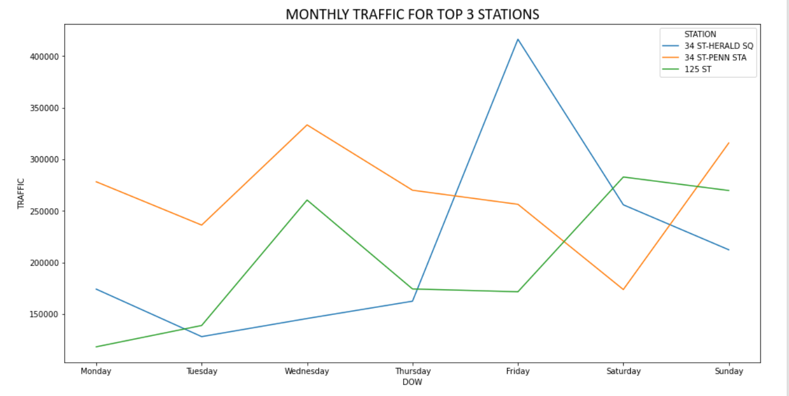
FINDINGS – WEEKLY TRAFFIC

Slide 11


OUR PROPOSAL…
Due to current COVID situation, daily ridership is affected, to recommend to postpone until situation gets better.
Focus on top 3 Stations (Manhattan Area):
34 ST-PENN STATION
34 ST-HERALD SQUARE
125th Street station (IRT Lexington Avenue Line)
Focus on Weekend over Weekdays

Slide 12



IF WE HAVE MORE TIME…
Analyze bigger dataset which covers a longer period of time to increase the accuracy and reliability of result derived
Incorporate demographic and geographical data to determine suitability of the commuters as the target for client
Find out the peak hours so that WTWY would know when are the best times to place their teams

Slide 13

Questions?
No?
Okay thanks bye… ☺

